Slide 1



Mental Health at Workplace

Slide 2
Our Team
Gowthami Middela
Ashish Manchala
Yasaswi Nallamothu
Gangai Kaliprasad Battula

Slide 3

Introduction
With the development of new data sources and analytical methods, data science has become more and more prevalent in the healthcare industry. In terms of mental health, there is a huge unmet demand in the world. Data science can contribute to our understanding of mental health issues. We may use data science to more fully comprehend and successfully apply treatments for mental health issues.

Slide 4
Challenge
How to handle mental health at the workplace
Mental Health affects mental, psychological, and social well-being. It also affects how we think, feel and act. It also helps us in determining how we handle stress by relating it to others. The impact of mental health on an organization can mean a lot of things: an increase in absent days from work, Decrease in productivity. In the US, approximately 70 percent of adults with depression are in the workforce. Employees with depression will miss a lot of days.

Slide 5
Solution
This problem can be solved using Mental Health First Aid. It helps participants to notice and support individuals who are suffering from mental health. It teaches employees communication and support skills which can help people suffering from mental health.
Research shows that employees who used first aid have increased awareness of mental health among themselves and their co-workers. It allows them to recognize the signs of someone who is struggling with mental health and teaches them the skills to when and where to reach out.
Moreover, they conduct an Employee Assistance Program which focuses on mental and physical health. These measures can help create a healthy and productive work environment that reduces the stigma associated with mental illness.

Slide 6
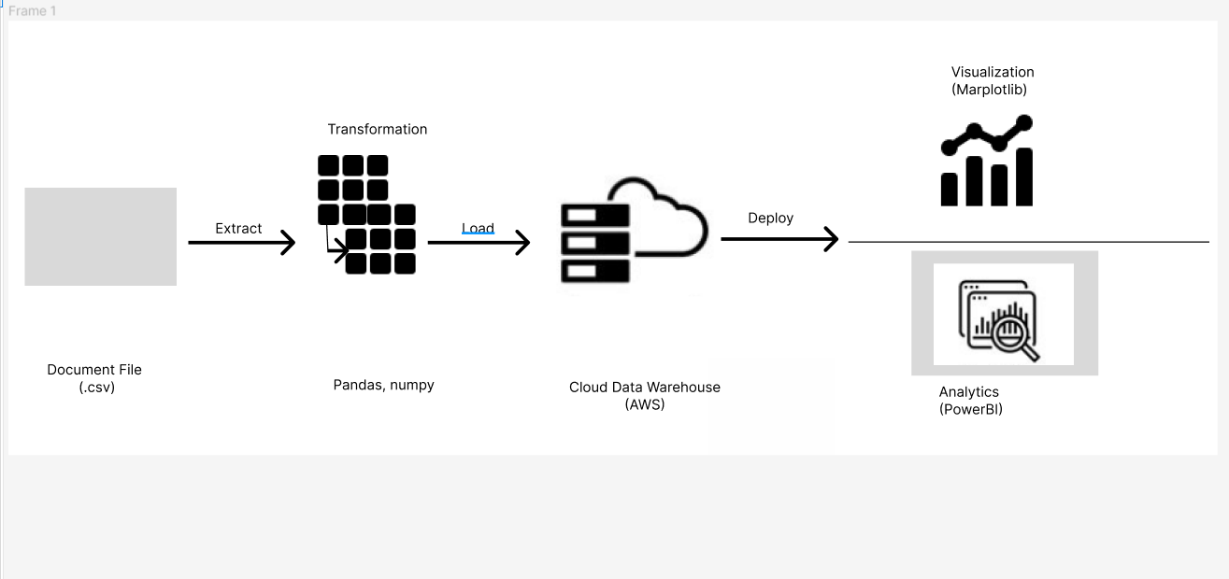
Graphical View of ETL Tools :

Slide 7
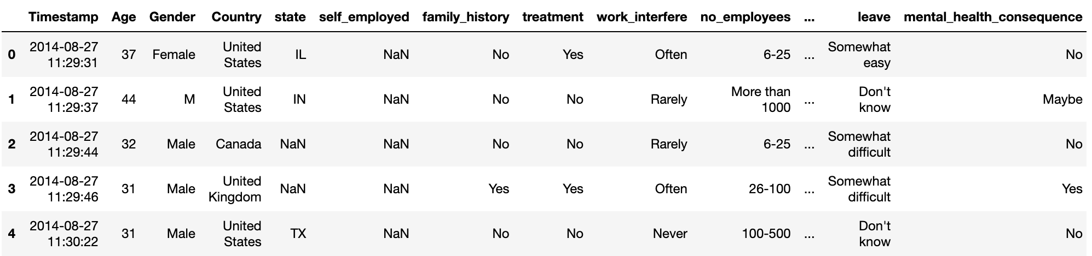
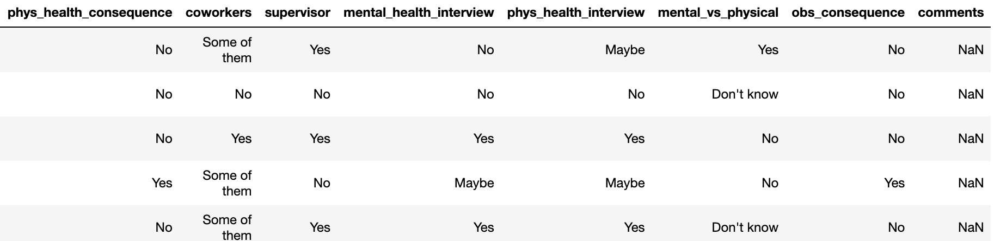
Data from Kaggle
https://www.kaggle.com/datasets/osmi/mental-health-in-tech-2016

Slide 8
Tools that we are going to use to solve this problem
JUPYTER: We use jupyter to load our dataset, and train and test the data using machine learning algorithms to predict the accuracy.
We Import Numpy, Scikit-Learn, Pandas, Matplotlib
AWS: We use AWS for hosting the web application into a flask server.

Slide 9
Models that we are going to use to solve this problem
We are going to use Random Forest Classifier, Gradient Boost and AdaBoost Classifier as they are going to give higher accuracy than other models since they are combinations of different models.

Slide 10
Reference
https://www.kaggle.com/datasets/osmi/mental-health-in-tech-2016

Slide 11
Thank You

